Slide 2
www.sharplex.com
Sharplex Strength

Slide 3
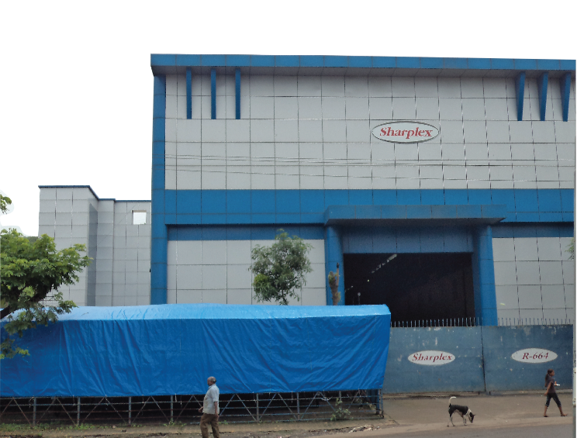
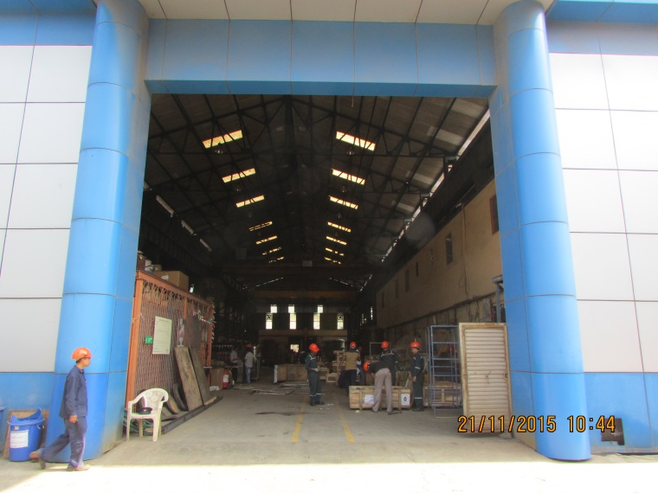
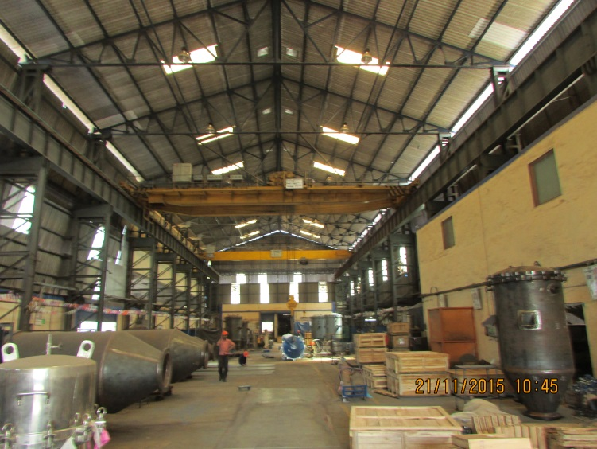
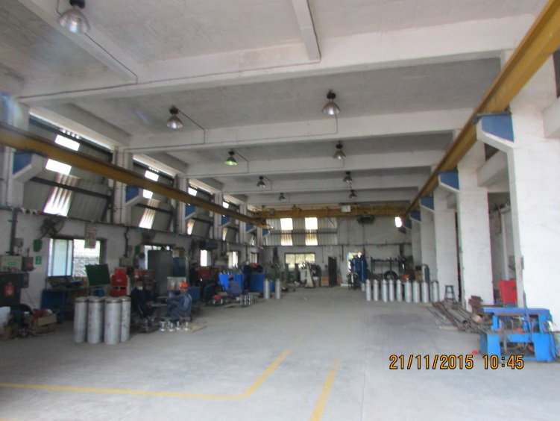
External view
Sharplex Factory R - 664
www.sharplex.com
Outside Factory
Inside Factory
Inside view

Slide 4
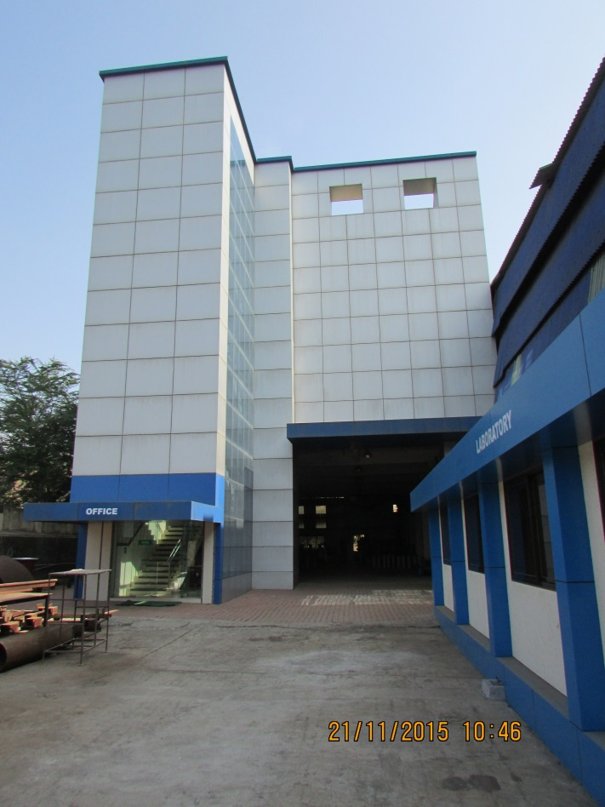
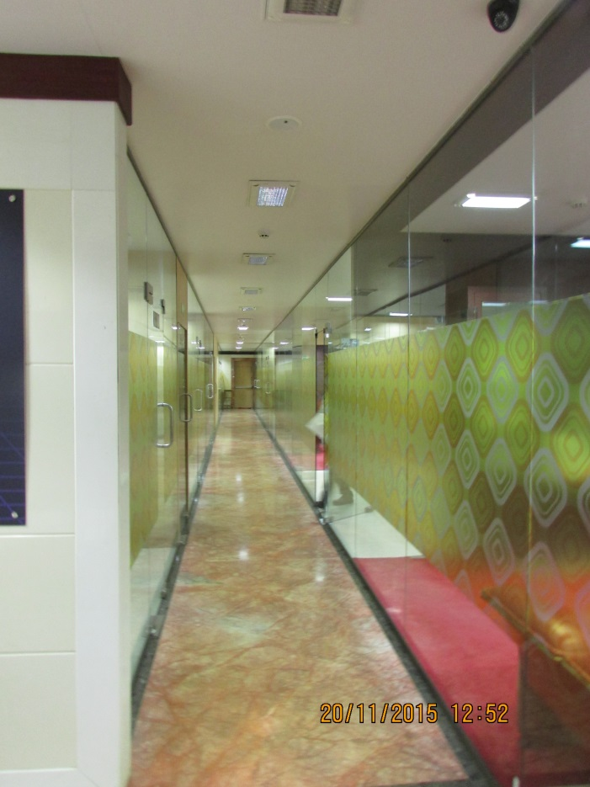
Administrative Office Building
Continued…
Sharplex Factory R -664
www.sharplex.com
Inside Office

Slide 5
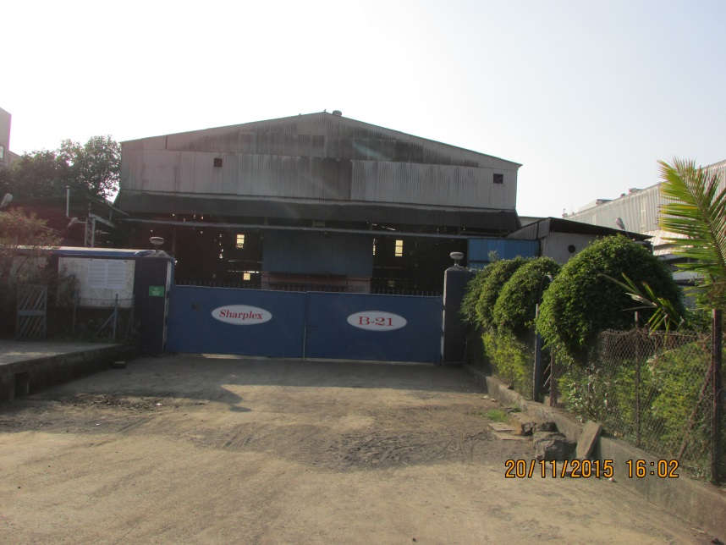
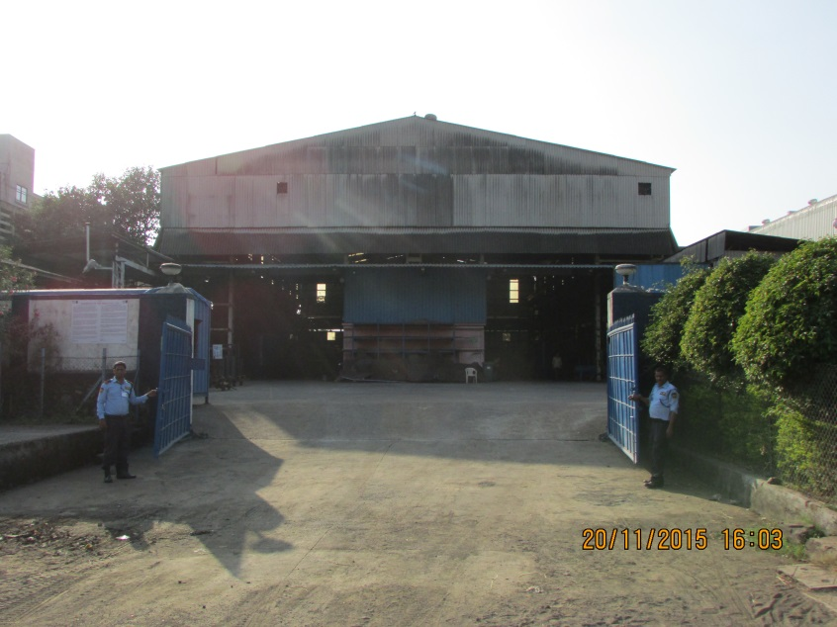
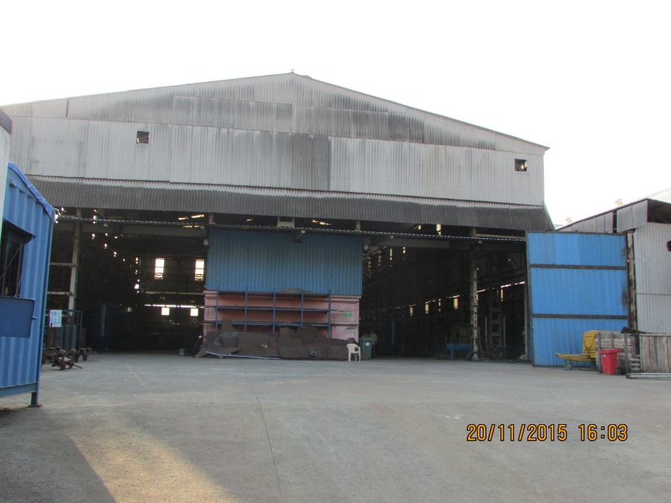
Sharplex Factory B -21
www.sharplex.com
External view
Internal view

Slide 6
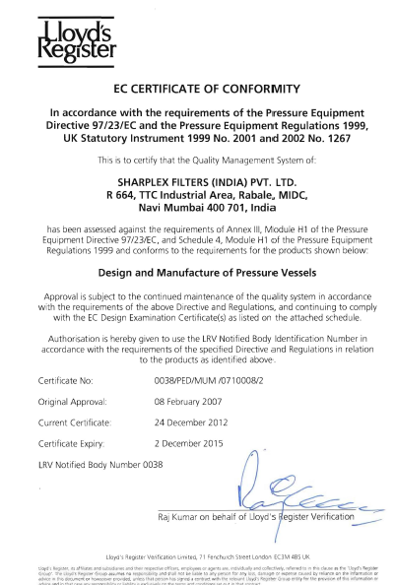
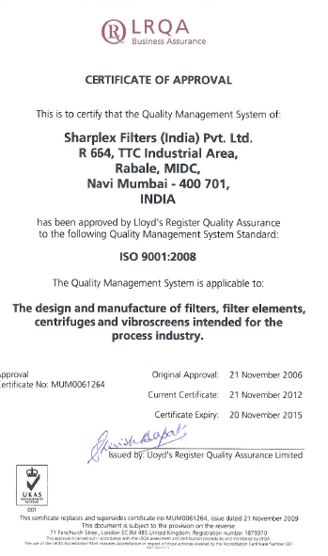
Certifications
www.sharplex.com

Slide 7
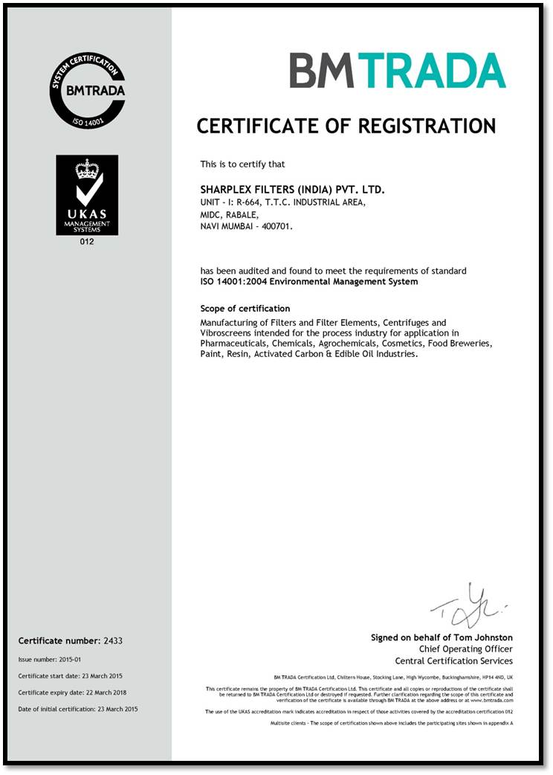
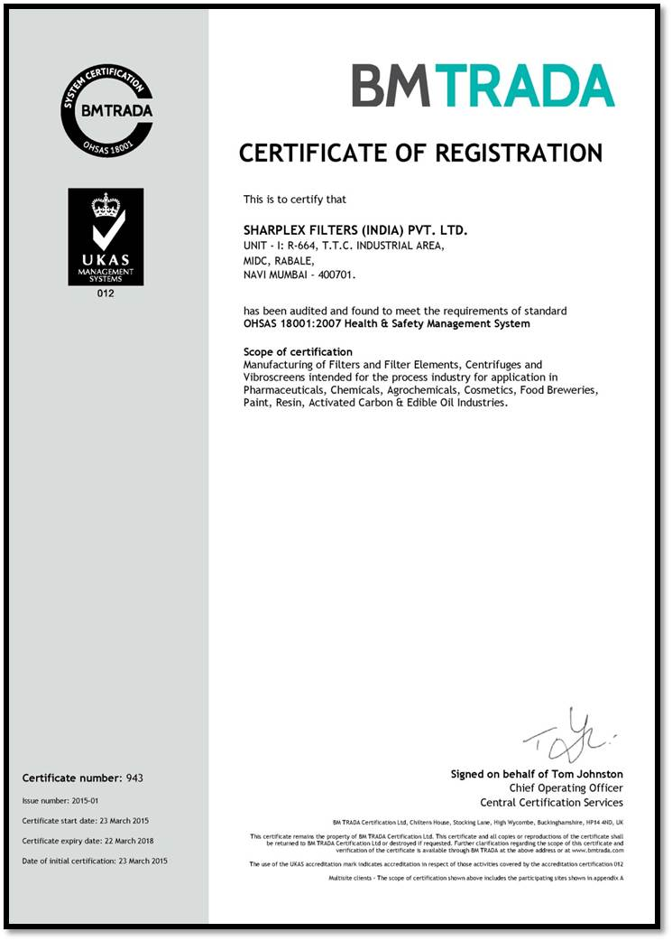
Certifications
www.sharplex.com

Slide 8
www.sharplex.com
Departments

Slide 9
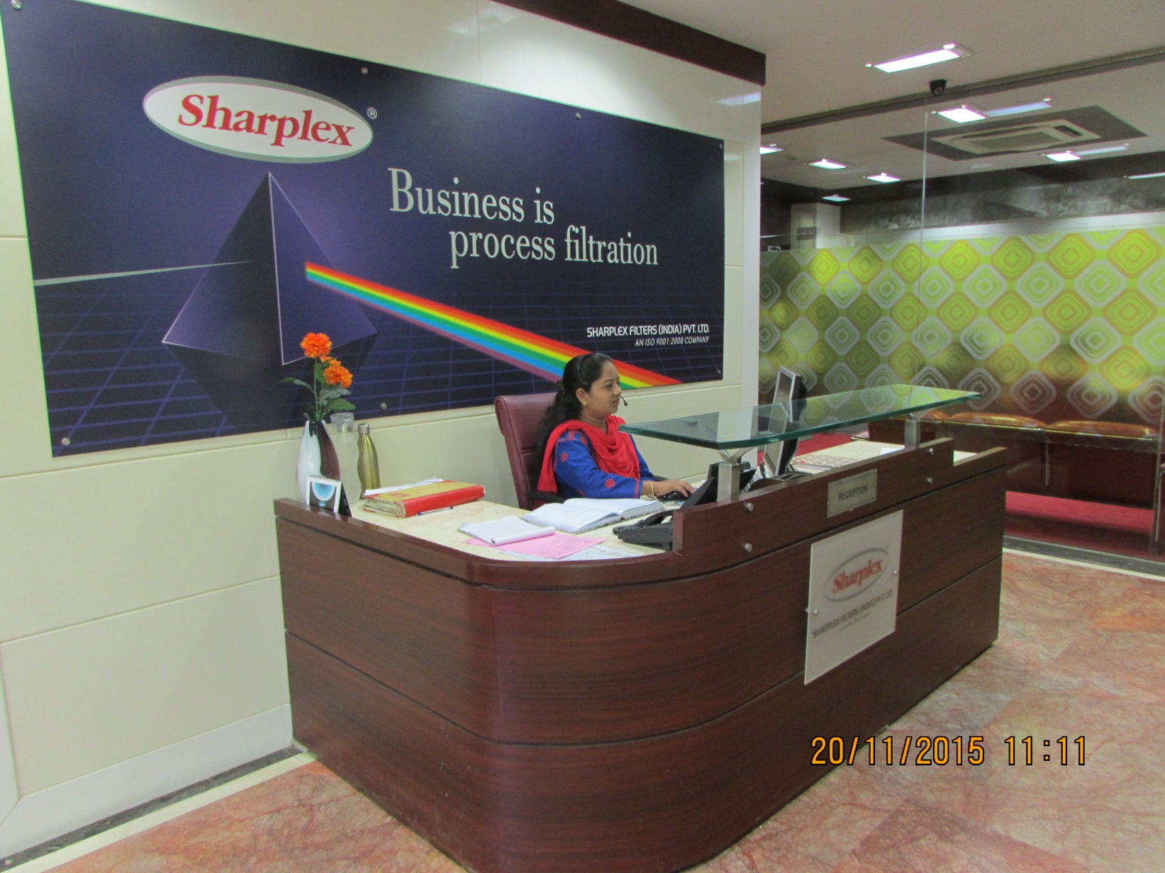
Reception
www.sharplex.com

Slide 10
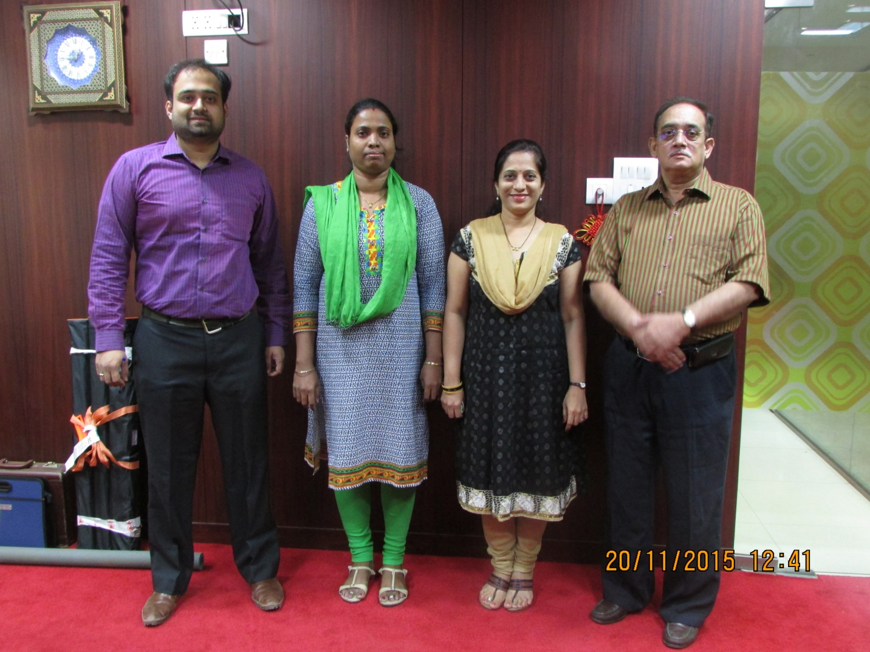
Sales & Marketing
www.sharplex.com

Slide 11
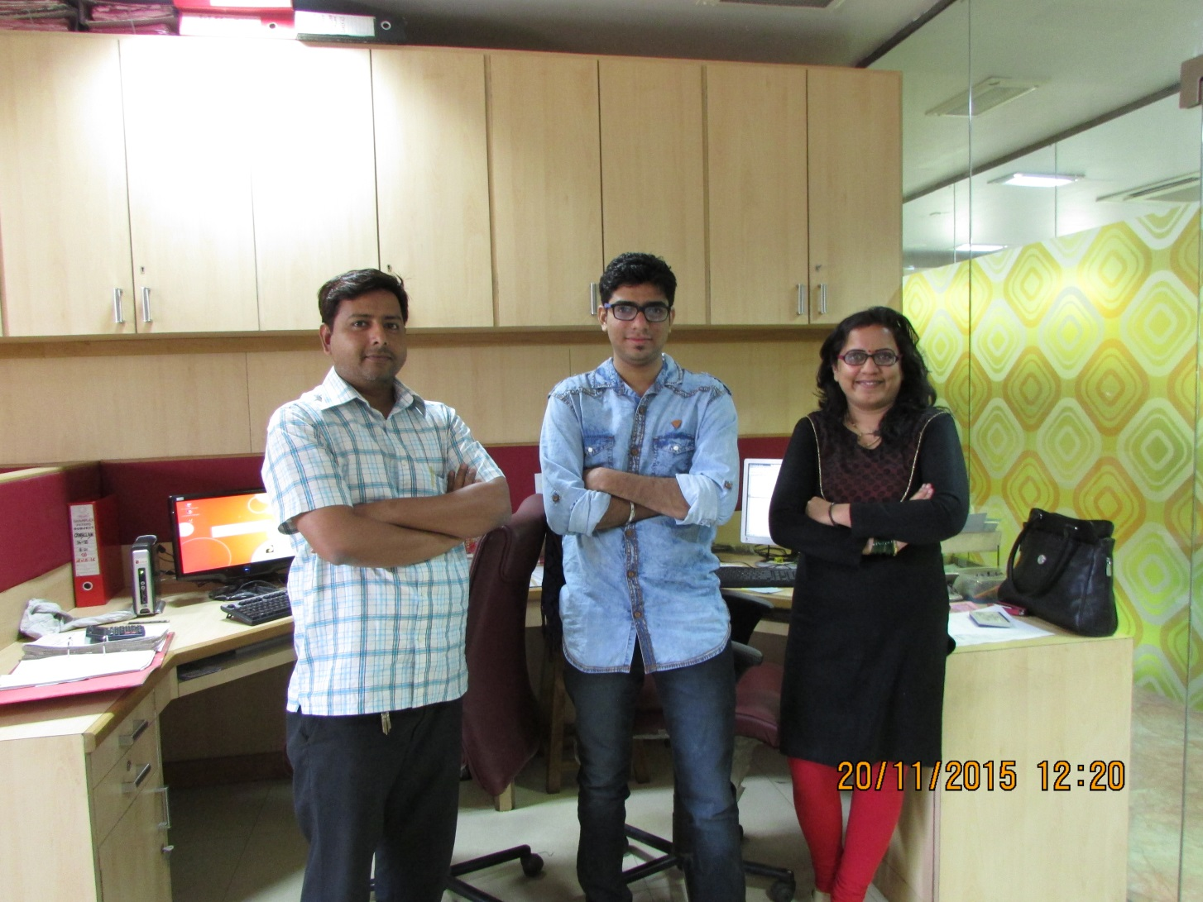
Sales & Commercial Dept.
www.sharplex.com

Slide 12
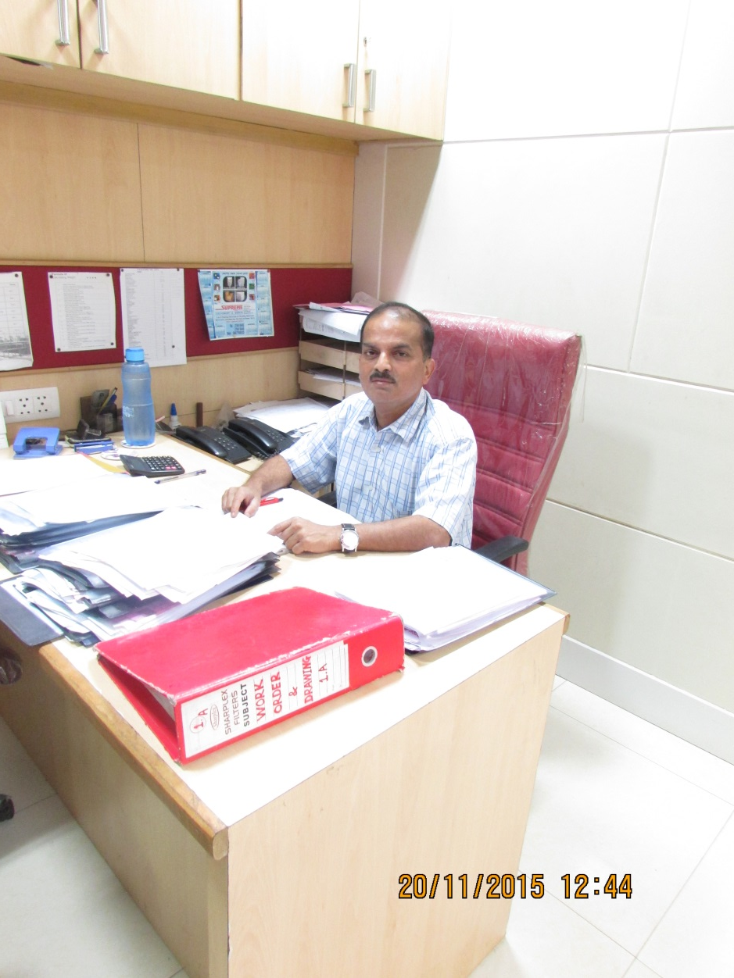
Works Manager Dept.
www.sharplex.com

Slide 13
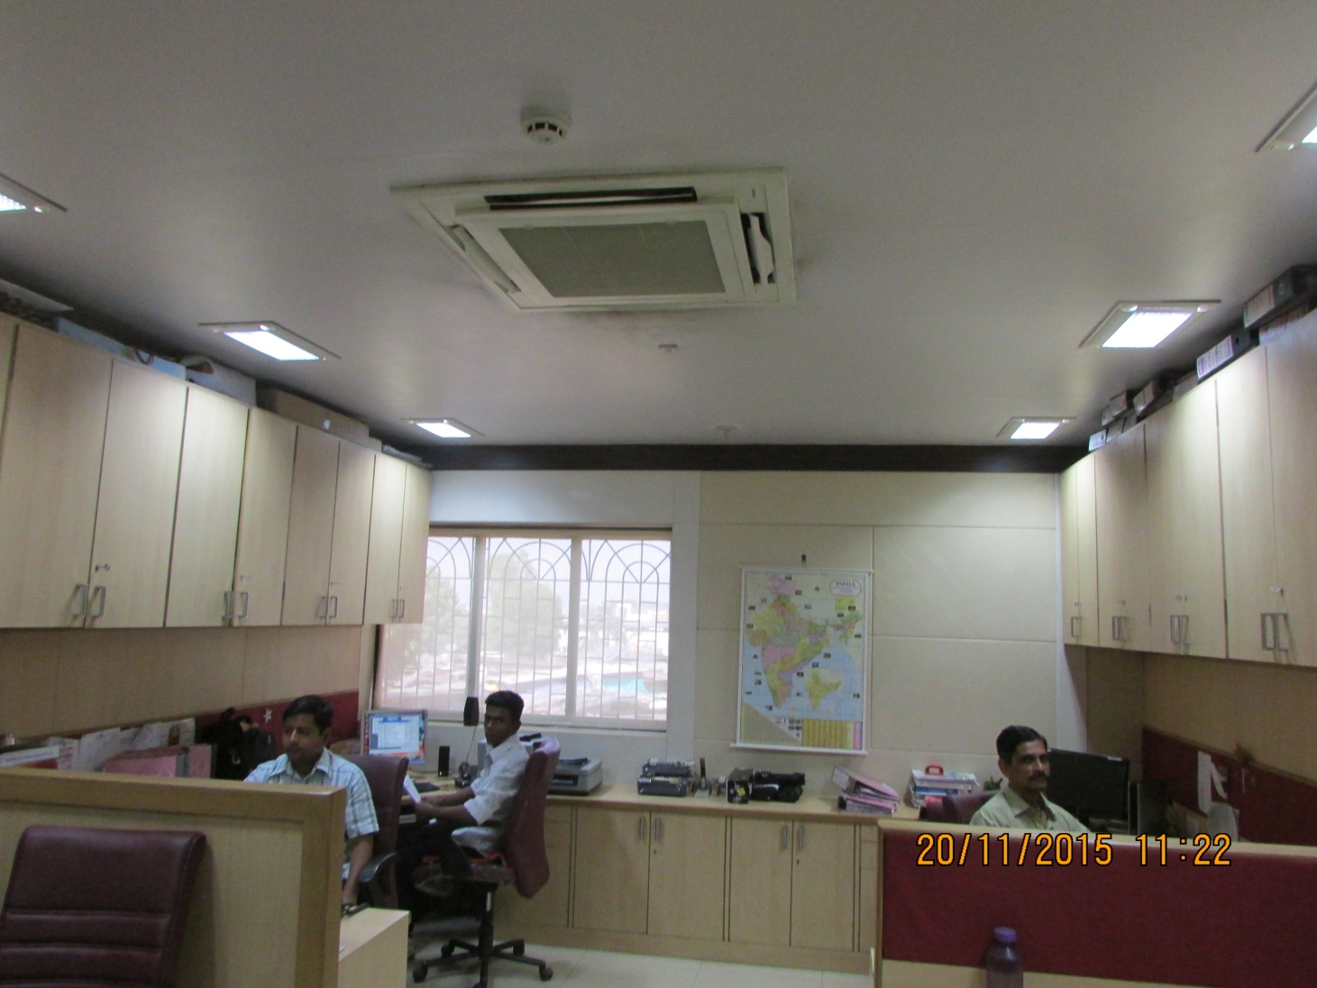
Sales & Commercial Dept.
www.sharplex.com

Slide 14
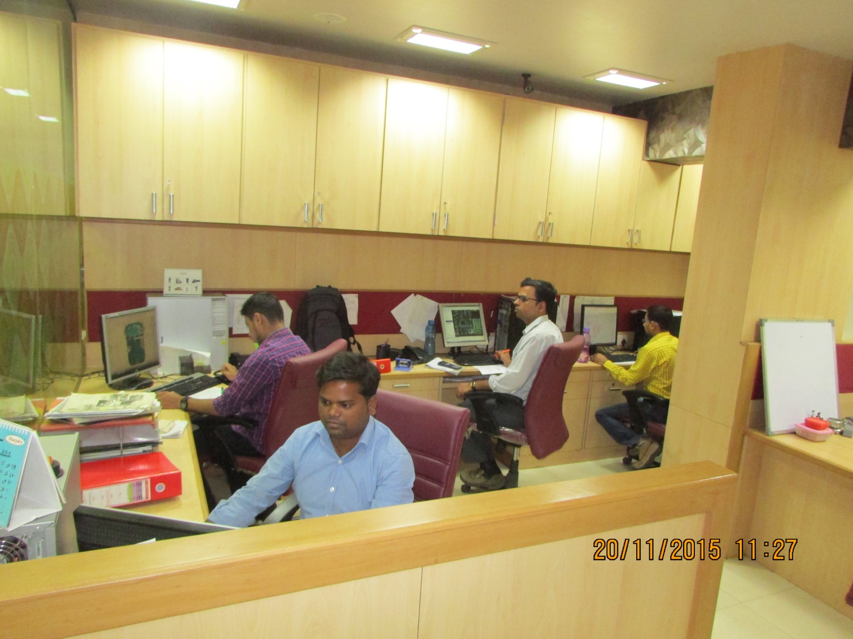
Design Department
www.sharplex.com

Slide 15
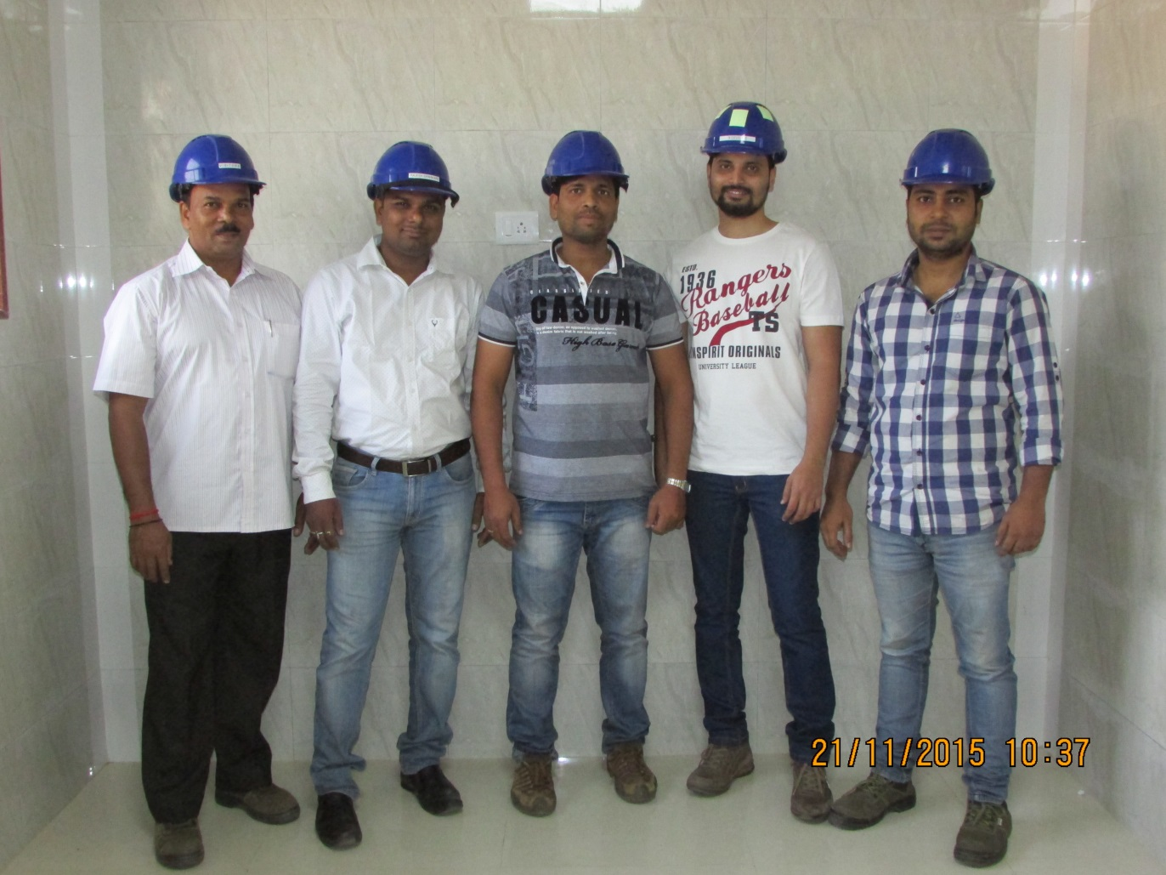
Quality Control Dept.
www.sharplex.com

Slide 16
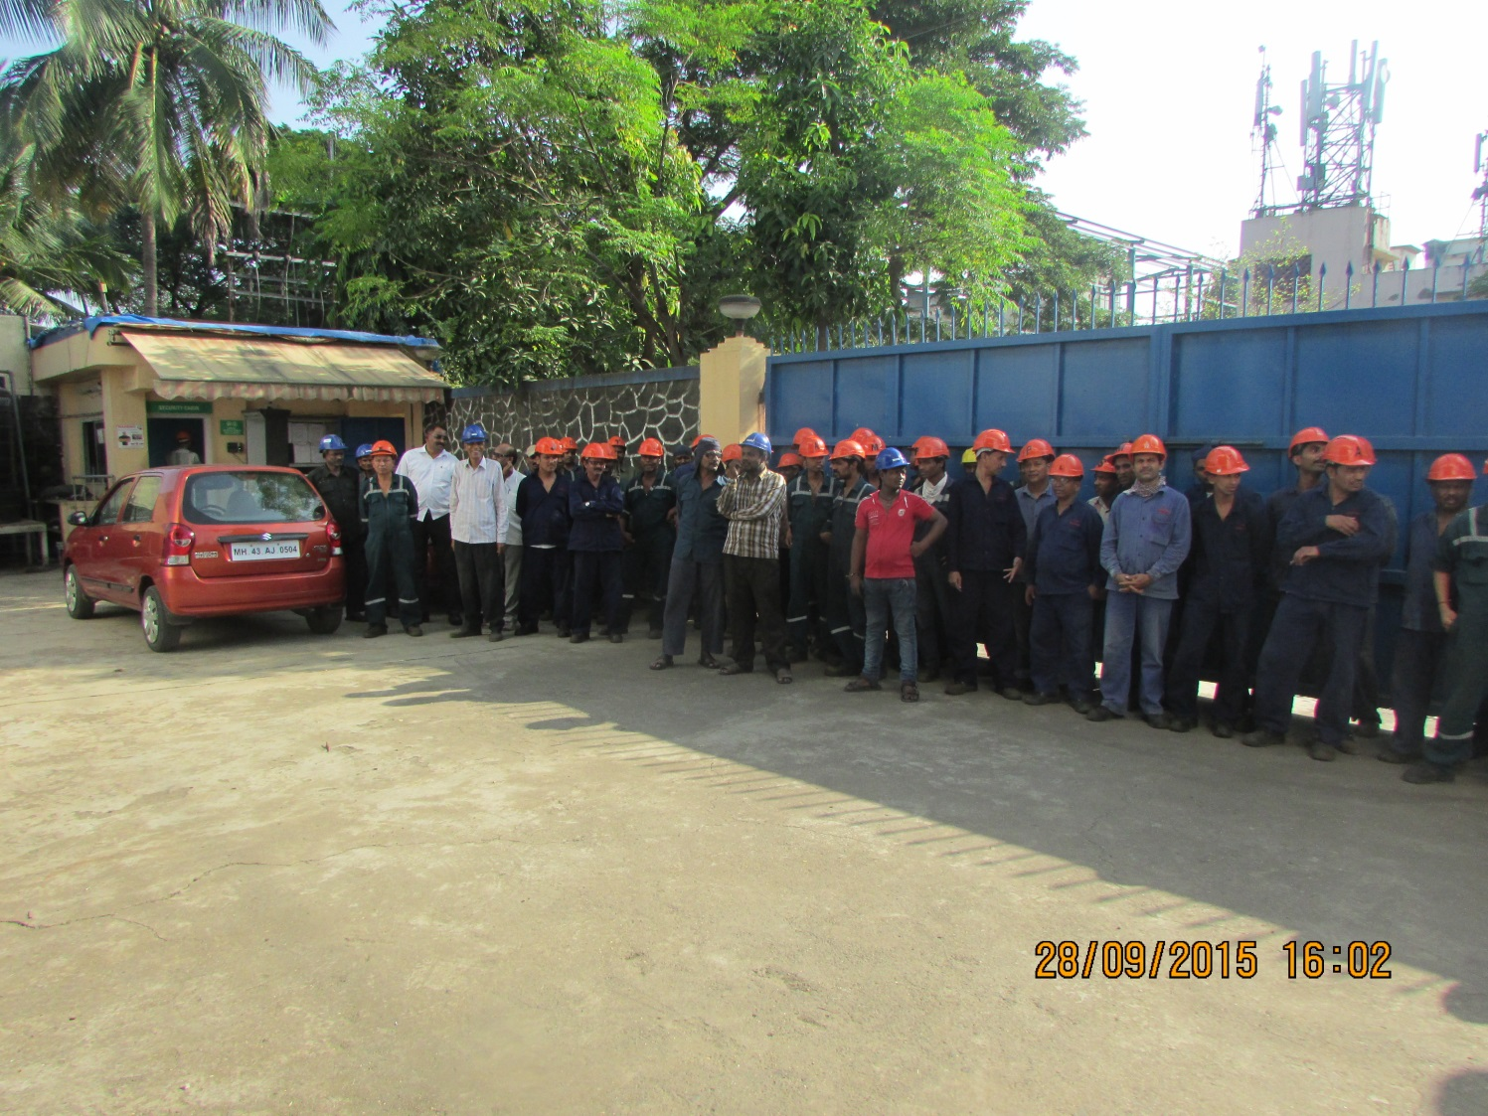
Factory Workmen
www.sharplex.com

Slide 17
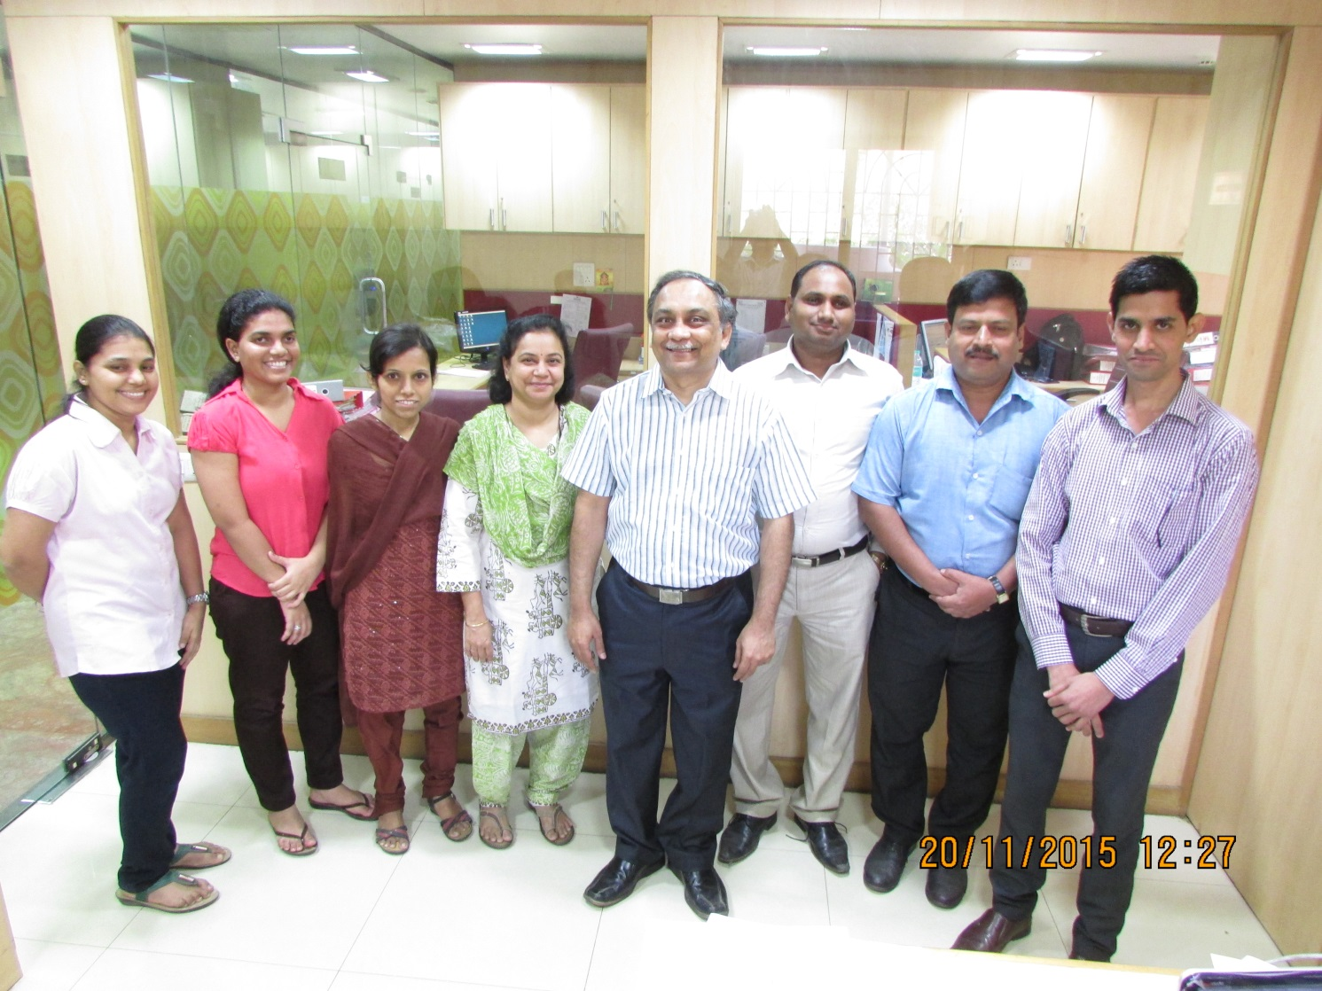
Accounts Dept.
www.sharplex.com

Slide 18
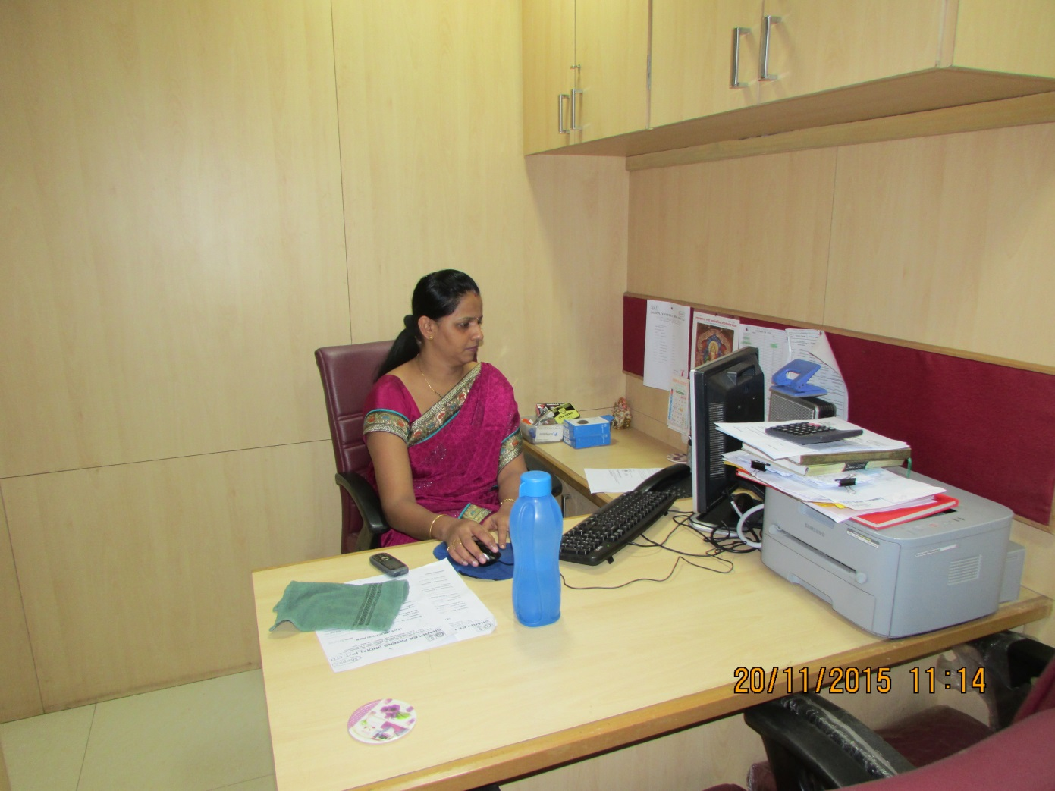
Human Resources
www.sharplex.com

Slide 19
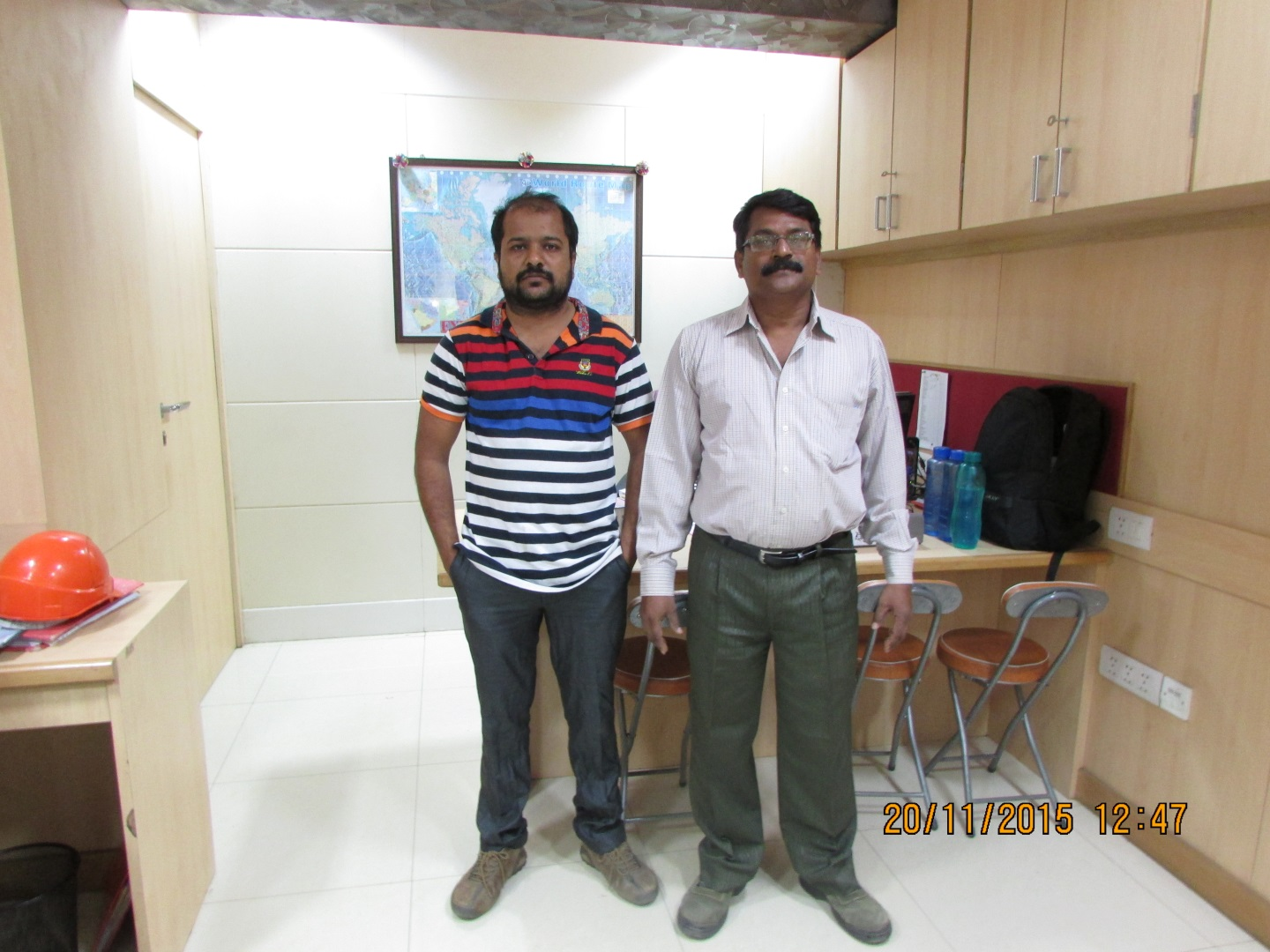
Import – Export Dept.
www.sharplex.com

Slide 20
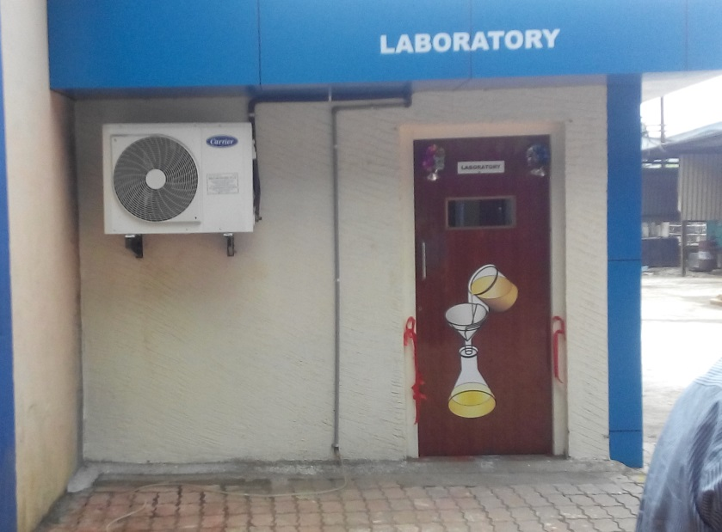
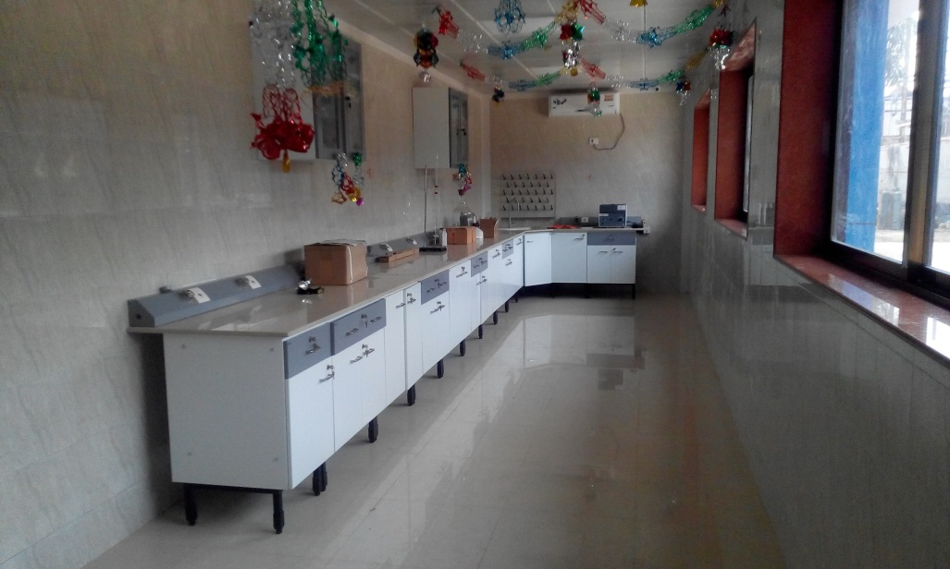
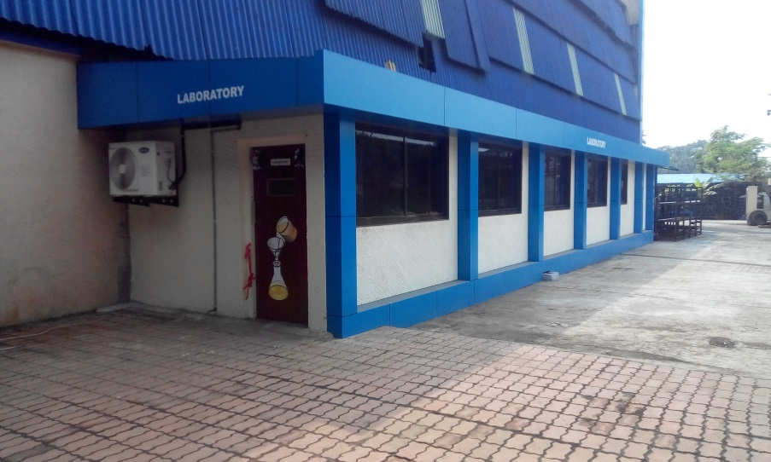
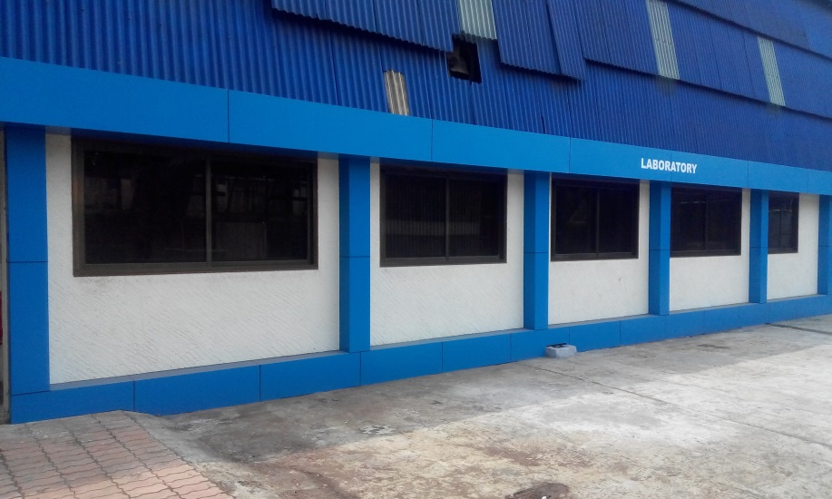
Research & Development
www.sharplex.com
Outside view
Inside R&D

